Slide 1
Decreasing monthly money spent
Nathan Kistler

Slide 2
Business Case
The average monthly credit card spend over the past 2 years is $5986 with a positive trend over time. Through reduction of the monthly credit card spend by 10% it is estimated that yearly savings would be ~$7.2K. These funds can be reallocated to savings accounts to provide future financial benefit to family members.
DEFINE

Slide 3
Problem & Goal Statement
Y Metric: Monthly spend
Problem: The current monthly credit card spend of $5986 is too high.
Goal: Reduce monthly spend by an average of 10% ($599) over the next 3 months.
DEFINE

Slide 4
Operational Definition
Monthly spend is defined as the monthly amount of money spent as measured by the monthly spending feature on the Intuit mobile Mint application.
MEASURE

Slide 5
Current State
The average monthly spend over the past two years is $5986 as measured by the descriptive statistics feature in Excel.
The average monthly spend has increased from $4452 to $7827 from 2022 to 2023, respectively.
The increase is supported by the trendline with a positive slope.
MEASURE

Slide 6
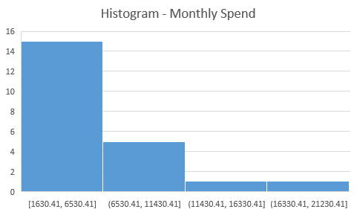
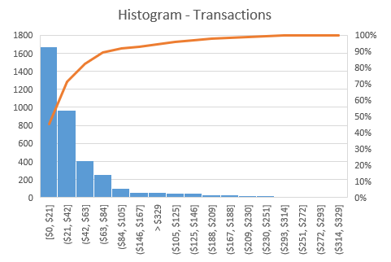
Current State
The monthly spend is right-skewed with most months in 2022 and 2023 having between $1.6K and $6.5K.
The individual transactions are also right skewed with transactions less than $84 making up 90% of the total transactions.
MEASURE

Slide 7
Current DPMO/Sigma Level
There will not be a DPMO/Sigma Level for this metric. That is because spending money should not be labeled as a defect. Making transactions in varying amounts in a necessity and it is not possible to label a threshold amount as a “defect”.
MEASURE

Slide 8
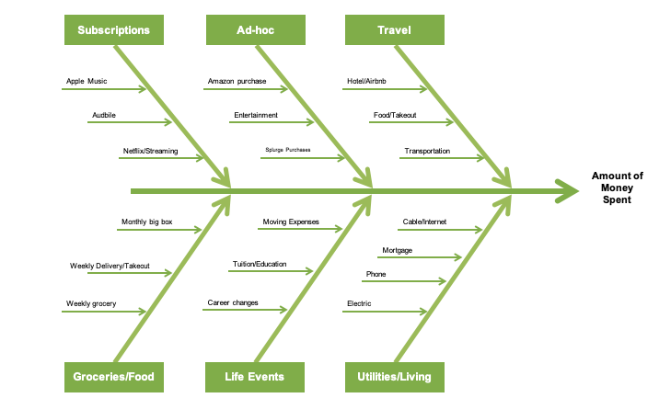
Analysis – Fishbone Diagram
ANALYZE

Slide 9
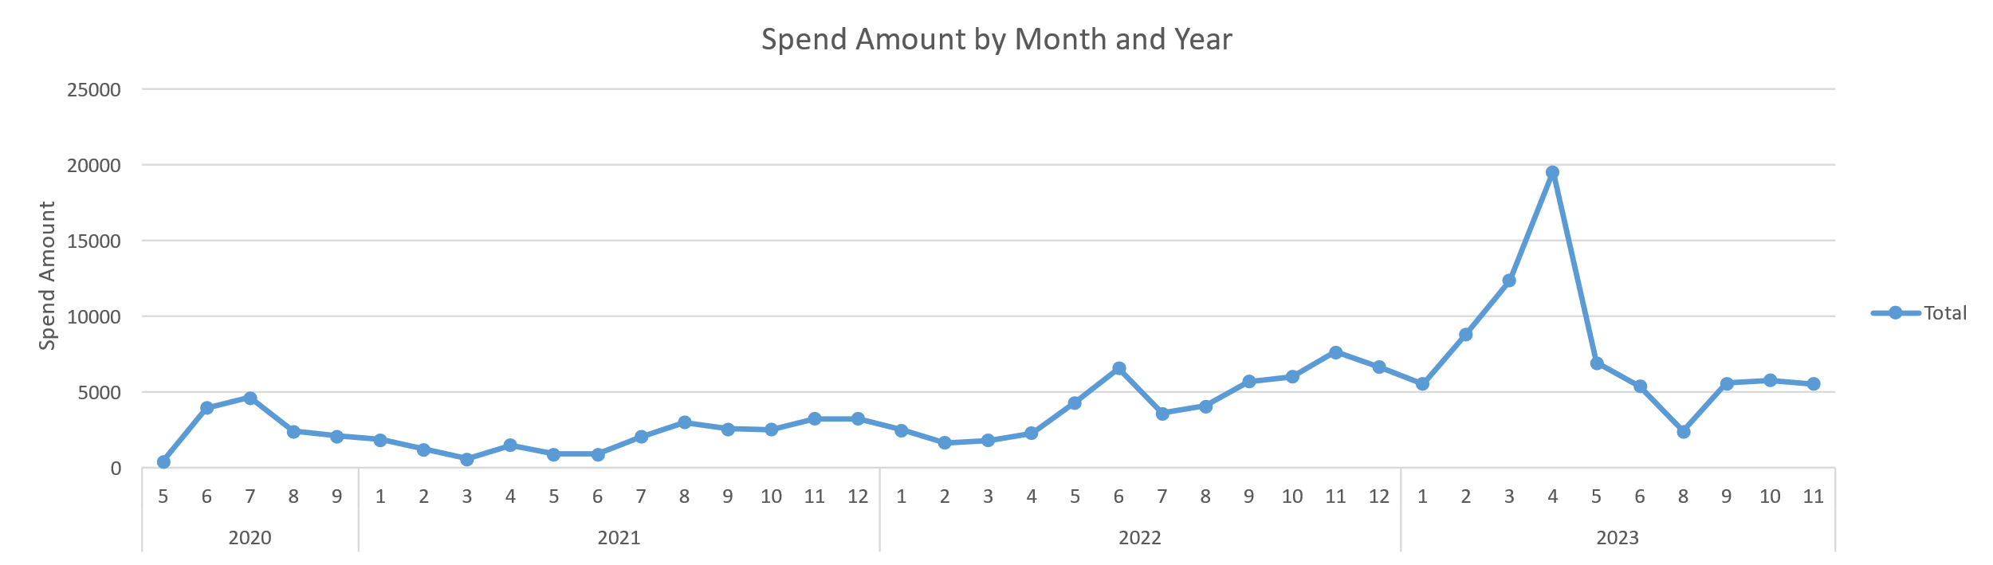
Analysis – Amount Spent by Time
Spend remain relatively constant from May 2020 – Q1 2022
The increase after Q1 2022 coincides with an addition to the family
There is significant peak in amount spent at the end of Q1 2023
The peak coincides with moving expenses due to personal reasons.
Spending dropped to normal amounts after Q1 2023
ANALYZE

Slide 10
Analysis – Spend Categories
Spend amount is categorized and sorted in descending amount to show the top 10 categories
Unsurprisingly, food related expensed (Groceries and Restaurants/Take Out) are the top 2 categories
Pets is number 3 driven mainly by monthly health insurance payments and boarding expenses
Amazon expenses are their own category and act as a significant contributor the the amount spent.
ANALYZE

Slide 11
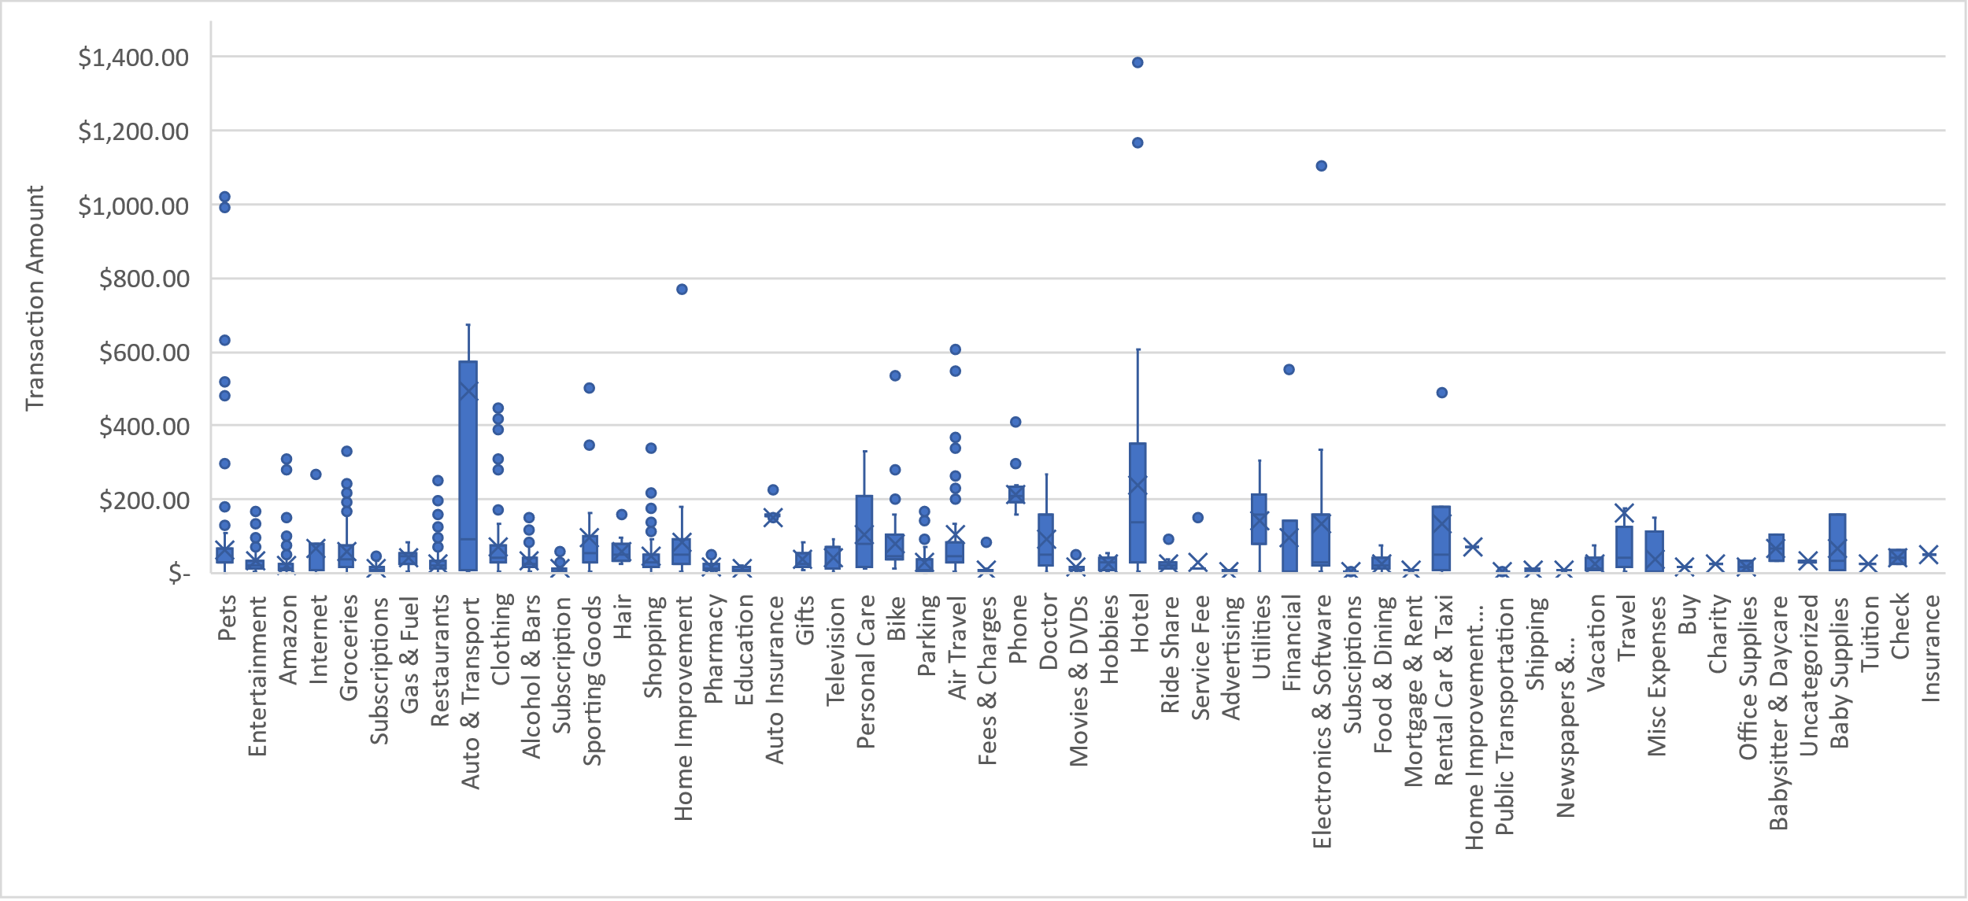
Analysis – Spend Categories (Individual Transactions)
Pets is the 3rd highest category in amount spent. It appears largely driven by outliers greater than $500 that drive the increase.
There were no expenses in the categories of groceries, restaurants, and amazon greater than $500 although they were the 1st, 2nd, and 4th highest categories, respectively. This indicates these categories were largest driven by a lot of relatively small transactions
ANALYZE

Slide 12
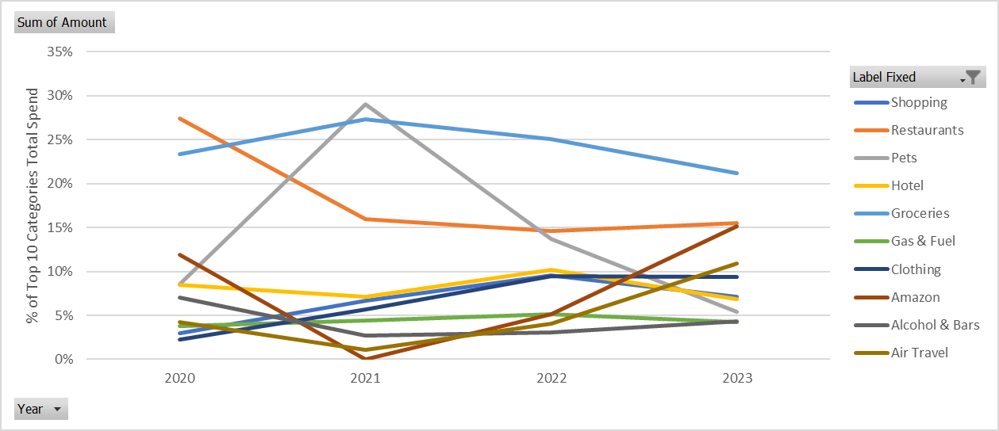
Analysis – Category % of Monthly Spend
Grocery and Restaurants are consistently were the two highest categories measured by % of yearly spend for all years measured.
Amazon replaced Pets as a top 3 category in 2023 compared to 2021 and 2022. Amazon is almost equivalent to restaurants in monthly spend % in 2023.
ANALYZE

Slide 13
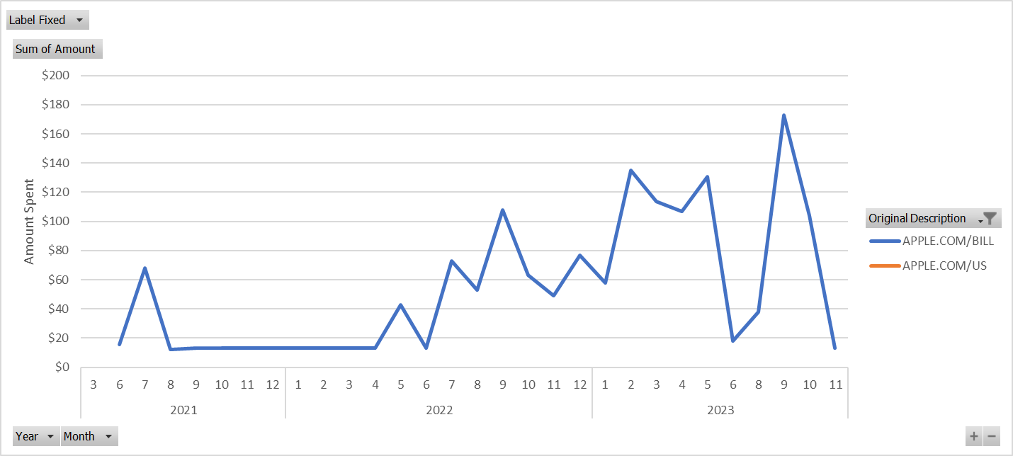
Analysis – Subscriptions to Apple by Month
Subscriptions to Apple increased starting in Q2 2022.
The average amount spent per month in 2023 was $89.
ANALYZE

Slide 14
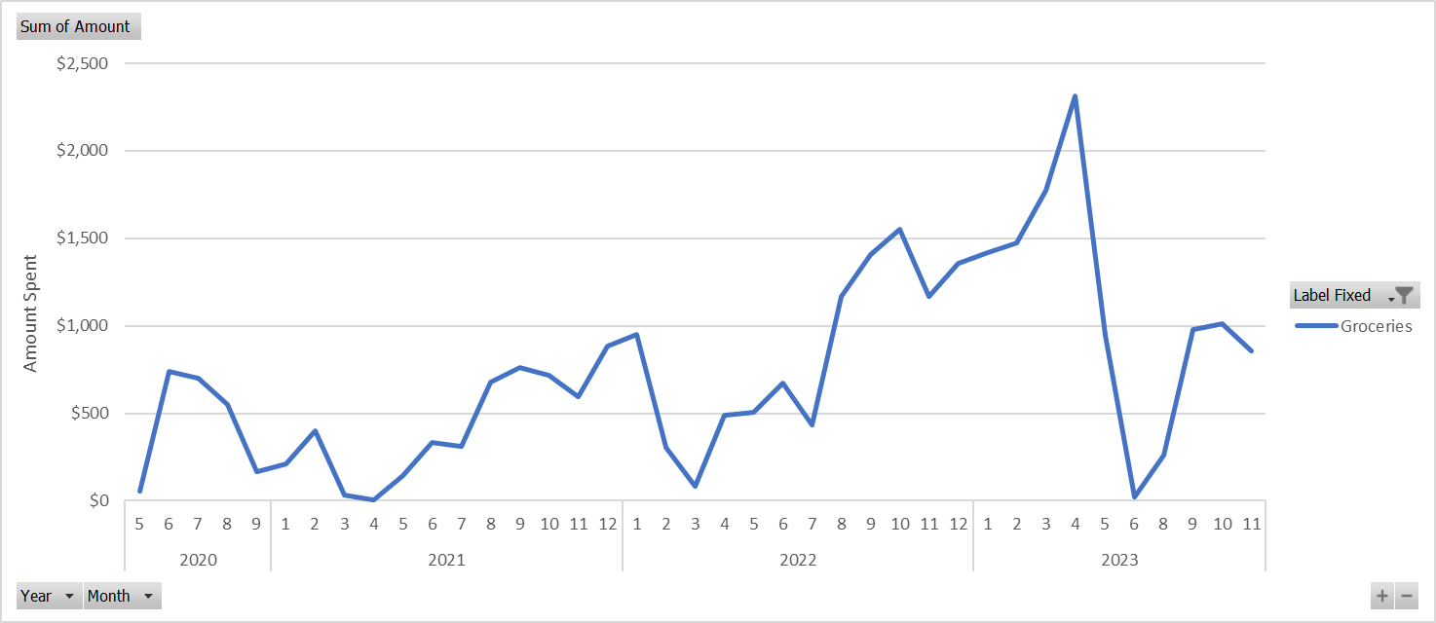
Analysis – Grocery Spend
The average amount of money spent on groceries in 2023 was $1.1K per month
The sharp reduction in May, June, July and August was due to changes in living arrangements that reduced the need for monthly groceries. This is not anticipated to continue in the future and should be ignored for analysis sake.
Discounting these months the average rises to $1.4K
ANALYZE

Slide 15
Recommendations
Over 2023 amazon purchases averaged a total of $790 per month. Through further analysis, budgeting and reduction of superfluous spending amazon purchases could be cut by 50% resulting in a savings of $395 per month. This cost cutting measure would account for 57% ($395/$699) of the total goal (i.e., cutting 10% of monthly spend).
The control recommended would be to continue tracking amazon spending to ensure the budget of $395 per month is not exceeded.
Subscriptions to Apple started rising in Q2 2022. The average amount spent per month in 2023 was $89. Reducing the amount spent to Apple to 2021 levels (i.e., $18 per month) would result in a savings of $71 per month. This cost cutting measure would account for %10 ($71/$699) of the total goal.
The control recommended would be to continue tracking monthly spend on subscriptions to apple. The monthly budget would be $18 per month and should not be exceeded.
RECOMMENDATIONS

Slide 16
Recommendations
Set a budget of $1K per month on groceries. This would result in a savings of $400 per month over the current normal state. This cost cutting measure would account for 57% ($395/$699) of the total goal (i.e., cutting 10% of monthly spend).
The control would be to continue tracking the grocery spend per month and ensure it does not exceed the budget recommended ($1K per month).
Following recommendations 1 and 3 would achieve the project goal of cutting monthly spend by 10%. It is estimated these measures would cut cost by $795 per month (13%).
RECOMMENDATIONS

Slide 17
Appendix A – Data Collection Plan
The data collection plan included transactional data from the Mint application for the past two and a half years. This amounted to 3676 total records that were analyzed in the present project.
The “Category” field included similar categories that should be agglomerated. Therefore, the “Label Fixed” field was created to correct mistakes and to create the “Amazon” category that accounted for Amazon purchases.
RECOMMENDATIONS

